Slide 1
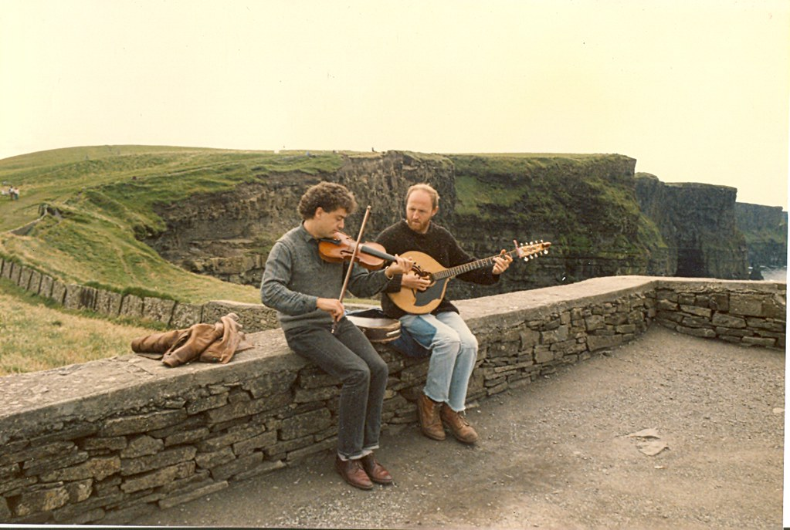
What Makes a Tune Popular?
Predicting the Popularity of Traditional Irish Tunes
DSC 530 – Data Exploration and Analysis
Dallin Nielson
This Photo by Unknown Author is licensed under CC BY-NC

Slide 2
Background
As someone who enjoys listening to and playing traditional Irish music, I frequently visit TheSession.org to look for new music to play, and to manage tunes that I’ve already learned.
As my musical skills have increased, I’ve become interested in the possibility of posting my own compositions onto the website for others to view.
If I do post my own music to the website, I would like to maximize the possibility that others will see and use my compositions, so I’m interested in exploring factors that are associated with increased engagement with tunes.

Slide 3
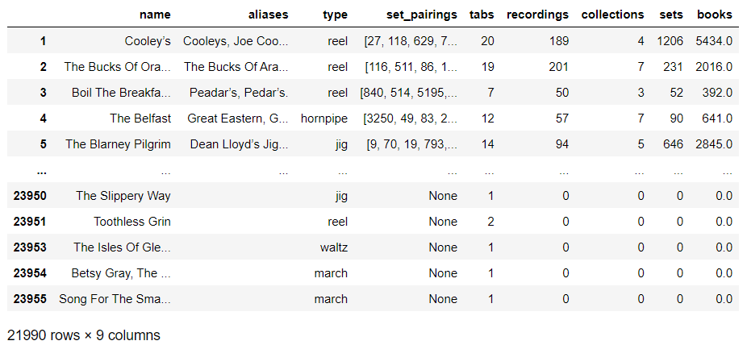
Building a Dataset
In the session_tunes.py file, I utilized the requests, bs4, and pandas modules to collect data from tunes on TheSession.org.
The final tunes dataset was written to tunes.json and consists of 21,990 observations and 9 variables.
A sample of observations from tunes.json after being loaded into a Pandas DataFrame

Slide 4
Key Variables
Of the 9 variables in the Tunes dataset, I selected the following 5 for my analysis:
Tabs: an integer representing the number of scores a tune has on its page
Type: a string representing the genre the tune falls under
Recordings: an integer containing the number of times the tune has been recorded on an album
Sets: an integer for the number of sets that the tune appears in
Books: an integer containing the number of people who have added the tune to their tunebook

Slide 5
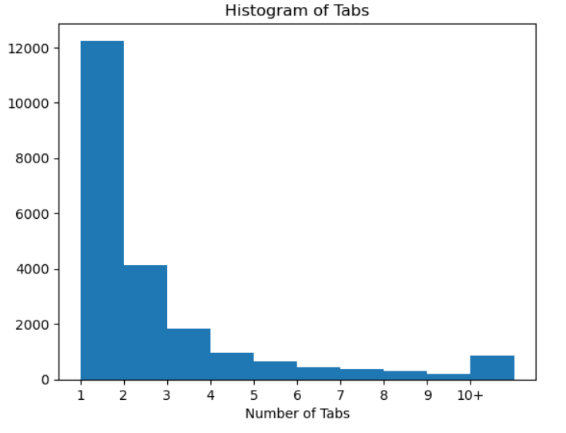
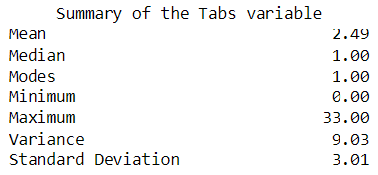
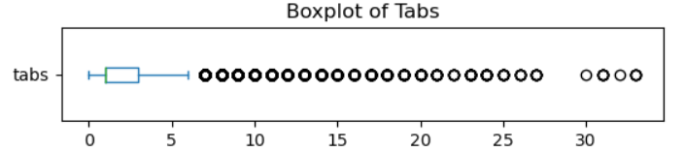
The Tabs variable
A tab (short for tablature) refers to the written musical notation, or sheet music, for a tune. On TheSession.org, the web page for a tune can have multiple tabs that are submitted by different authors, and which have slightly different arrangements.
The histogram shows that the distribution of tabs is heavily right-skewed.
Any tune with more than 6 tabs is an outlier in the data. However, these are likely to be important to the analysis, since my hypothesis is interested in whether tunes with more tabs are more popular.

Slide 6
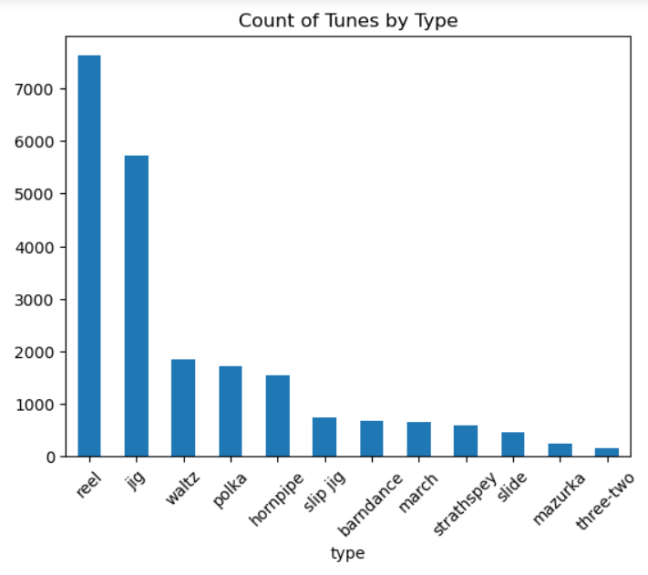
The Type variable
The Type variable shows a tune’s genre; tunes of the same type share certain characteristics like tempo and time signature.
The Reel and Jig tune types make up over half of the dataset
I selected this variable because I am interested if certain types of tunes are more likely to be popular

Slide 7
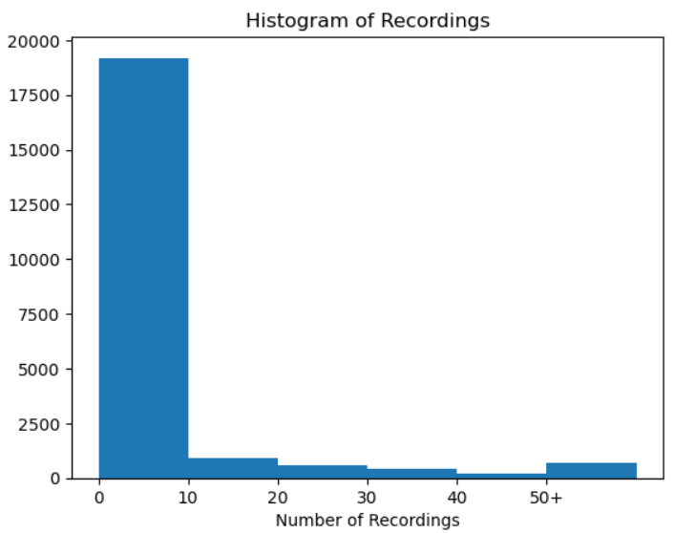
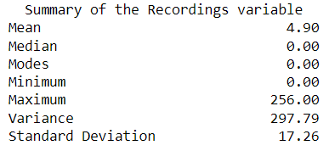
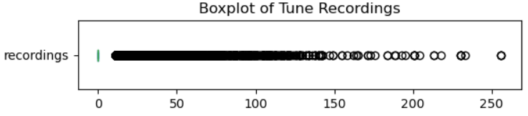
The Recordings variable
The recordings variable is a count of how many times a tune is played as part of a track in a recorded album or record
The data is heavily right-skewed, and 87.271% of tunes don’t appear in any recordings
Since most tunes don’t have any recordings and my research question is interested in tunes that are more popular, it might make sense to exclude tunes with no recordings from the analysis.

Slide 8
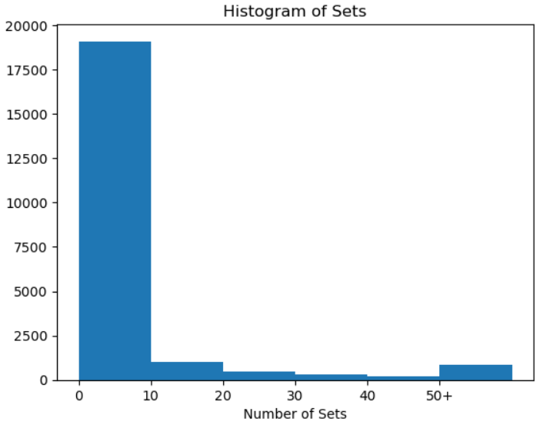
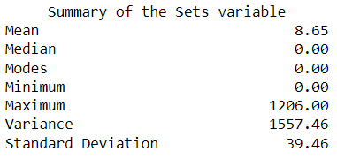
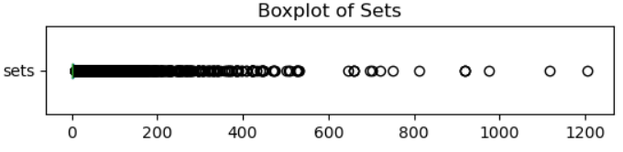
The Sets variable
Irish tunes are usually played in sets, which are groups of 2 or more tunes of the same tune type, each tune played one after another. On TheSession.org, users can create sets by grouping multiple tunes together in their desired order. The Sets variable indicates how many sets a tune has been added to.
The data is heavily right-skewed and has a large variance, with a few tunes appearing in large numbers of sets while most don’t appear in any.
Because the outliers are more important to my research question, it might make sense to drop tunes with zero recordings from the dataset

Slide 9
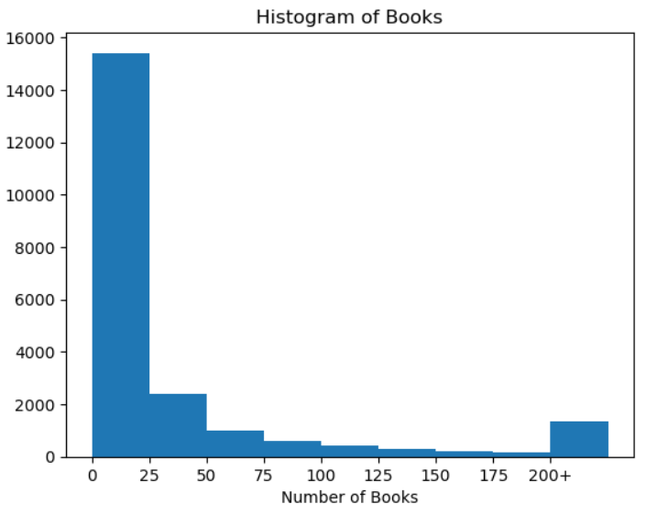
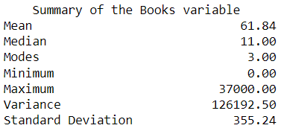
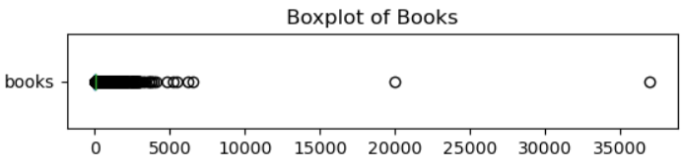
The Books variable
On TheSession.org, site users can add a tune to their Tunebook, which helps them keep track of tunes that they know or wish to learn. The Books variable is an integer that shows how many users have added a tune to their Tunebook.
The histogram shows that the distribution is heavily right-skewed.
The boxplot identified 2 major outliers (20k and 37k), which I identified as web scraping errors and recoded manually.

Slide 10
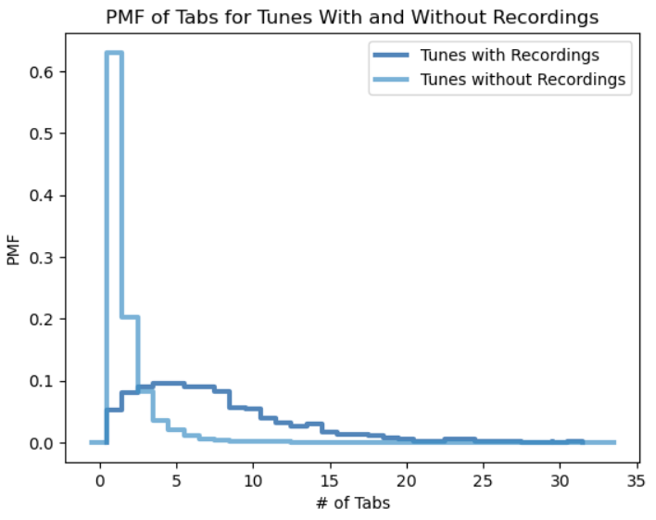
PMF of Tabs
I split the data into 2 groups – one where the Recordings variable was 0, and one where the Recordings variable was greater than zero. The plot shows the PMFs for each group of data.
The PMF of the “Tunes with Recordings” group is still skewed but is much more normal than the “Tunes without Recordings” group.

Slide 11
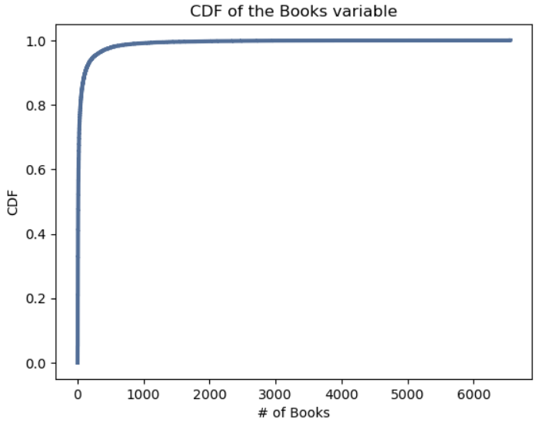
CDF of Books
The CDF plot of the Books variable shows that a very small number of tunes have been added to many user’s tunebooks (indicating that they are very popular), while most tunes belong to only a few tunebooks.
This helps with my research question by highlighting the fact that most tunes published on the site are not very popular with users. Publishing a popular tune is not very likely.

Slide 12
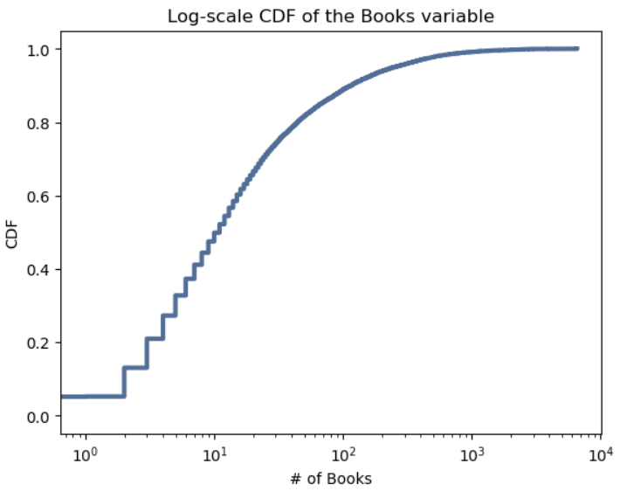
Log-scale CDF of Books
To see if the Books variable follows a Logarithmic distribution, I plotted its CDF on a Logarithmic scale.
The resulting line is straight at the lower portion but then curves again.
Even though this model doesn’t perfectly fit the data, it is a better fit than the normal distribution.

Slide 13
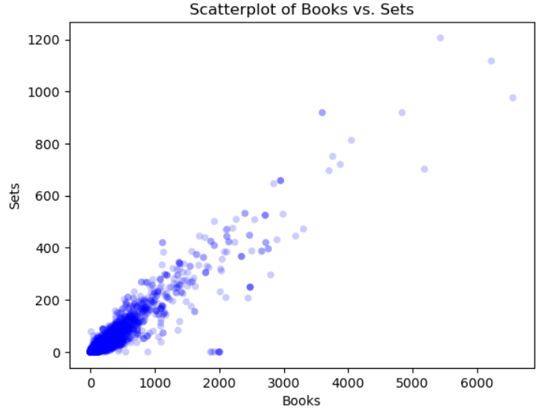
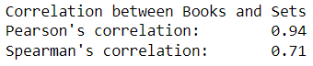
Scatterplot of Books vs. Sets
There is a strong positive correlation between the number of users that add a tune to their Tunebook and the number of Sets that the tune has been added to.
Pearson correlation = 0.94
Spearman correlation = 0.71
While the correlation is strong, we can’t conclude a causal relationship

Slide 14
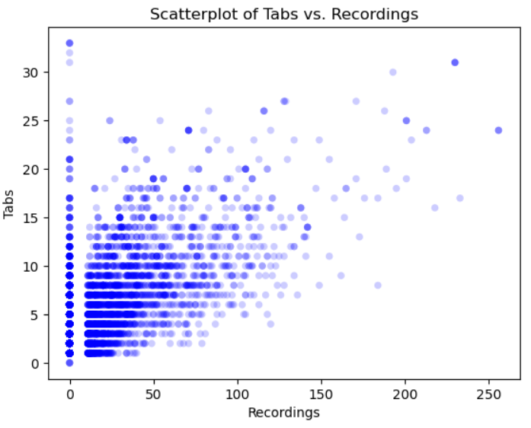
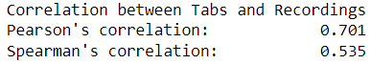
Scatterplot of Tabs vs. Recordings
There is a positive, moderately strong relationship between the number of Tabs a tune has and the number of times it is recorded on an album
Pearson correlation: 0.701
Spearman correlation: 0.535

Slide 15
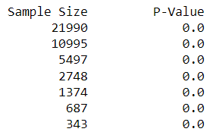
Hypothesis Test: Jigs & Reels vs. Other Tune Types
One of my hypotheses is that Jigs and Reels have higher Tunebook counts than other tune types.
To test this, I split my data into to subsets: one that contained Jigs and Reels, and another that contained all of the other types of tunes.
Then, I performed a hypothesis test on 7 different samples of the data to compare the mean number of books between the two groups to see if the difference was statistically significant.
For every sample, the P-values were statistically significant

Slide 16
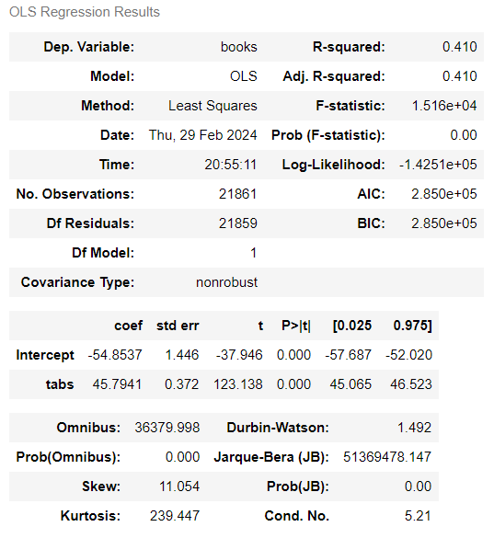
Regression Analysis
I selected the “books” variable as my dependent variable, because I believe it is a good measure for the overall popularity of a tune.
Because my goal is to maximize my chances of publishing a tune that achieves a high “books” count, I limited my potential explanatory variables to the ones that I could control. This left me with the “tabs” and “type” variables.
Surprisingly, the “type” variable did not explain very much of the variance in books, so I used “tabs” as my explanatory variable.
My regression model showed that the “tabs” variable explained around 41% of the variance in the “books” variable, with a statistically significant p-value.

